Slide 1
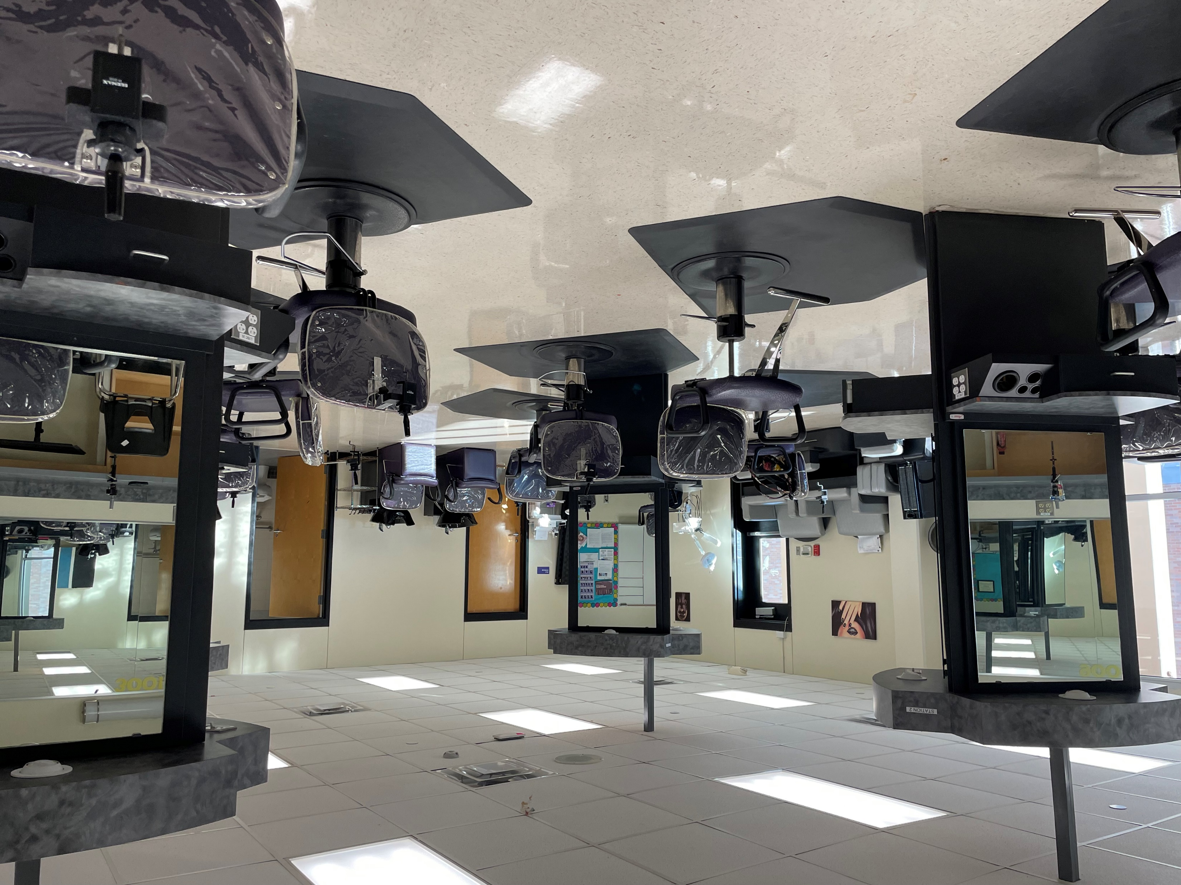
Cosmetology and Personal Care Services
Regional Program of Study
Human Services Career Cluster
The Human Services Career Cluster focuses on preparing individuals for employment in career pathways that relate to families and human needs such as counseling and mental health services, family and community services, personal care services, and consumer services.
The Cosmetology and Personal Care Services regional program of study introduces CTE learners to knowledge and skills related to providing beauty and personal care services. CTE concentrators may learn about or practice managing personal care facilities and coordinating or supervising personal service workers.
Work-Based Learning and
Expanded Learning Opportunities
Secondary Courses for High School Credit
1 Introduction to Cosmetology
2 Cosmetology I
3 Cosmetology II
Exploration Activities | Work-Based Learning Activities
Participate in SkillsUSA | Job shadow a cosmetologist Work part-time at a salon, spa, or barbershop
Industry-Based Certifications
Cosmetology Operator License
Postsecondary Opportunities
Certificate/License
Certified Aesthetic Laser Operator
Cosmetologist
Certified Spa Supervisor
Nail Technician/Specialist and Manicurist
Microdermabrasion Certificate
Associates Degrees
Cosmetology/Cosmetologist, General
Aesthetician/Esthetician and Skin Care Specialist
Salon/Beauty Salon Management/Manager
Cosmetology, Barber/Styling, and Nail Instructor
SMHS Venom Salon
Aligned Occupations
Occupations | Median Wage | Annual Openings | % Growth
First-Line Supervisors of Personal Service Workers | $36,941 | 1,634 | 24%
Barbers | $28,267 | 348 | 14%
Hairdressers, Hairstylists, and Cosmetologists | $48,522 | 3,489 | 22%
Manicurists and Pedicurists | $21,715 | 418 | 45%
Shampooers | $18,720 | 139 | 24%
Skincare Specialists | $26,437 | 637 | 22%
Successful completion of the Cosmetology and Personal Care Services regional program of study will fulfill requirements of the Public Service endorsement. Revised – August 2022

Slide 2
Cosmetology and Personal Care Services Course Information
COURSE NAME | SERVICE ID | PREREQUISITES | COREQUISITES
Introduction to Cosmetology | 13025100 (1 credit) 6327 | None | None
Cosmetology I | 13025200 (2 credits) 6328 | Introduction to Cosmetology | None
Cosmetology II | 13025310 (3 credits) 6326 | Cosmetology I | None
FOR ADDITIONAL INFORMATION ON THE HUMAN SERVICES CAREER CLUSTER,
PLEASE CONTACT: CJ Odam, SMCISD CTE Coordinator cj.odam@smcisd.net
San Marcos CISD does not discriminate on the basis of race, color, national origin, sex, disability or age in its programs or activities and provides equal access to the Boy Scouts and other designated youth groups. The following person has been designated to handle inquiries regarding the nondiscrimination policies: Stephanie Munoz ; 631 Mill St, San Marcos, TX 78666 ; 512-393-6700 ; stephanie.munoz@smcisd.net
Further nondiscrimination information can be found at smcisd.net/cte

