Slide 1
San Marcos CISD
Equity Audit Report
06/21/2021
Dr. Tracey A Benson & Dr. David J. Wallace

Slide 2
Our Time Together
Systems & Structures: 10 mins
Q&A: 5-7 mins
Curriculum & Instruction: 10 mins
Q&A: 5-7 mins

Slide 3
Overview
Equity analysis to identify high level trends
Schools in Study
Hernandez Elementary
Crockett Elementary
Mendez Elementary*
Miller Middle School
San Marcos High School
Goodnight Middle School (disciple data only)
Areas of Study
Attendance
Discipline
Drop Out
Racial Climate Survey
*Damaged data file

Slide 4
Major Findings
Attendance
Discipline
Drop Out
Racial Climate Survey
Chronic Absenteeism has been dropping over the last year years.
Not all student groups benefit from this trend.
Middle School has a higher proportion of discipline compared to their enrollment numbers.
Dropouts are on an upward trend.
Incidents of racism are not being reported.

Slide 5
Attendance - Overview
Overview:
Our study focused on Chronic absenteeism defined as either 18+ days absent (Elementary) or 201+ periods absent (MS & HS).
Sample:
Years Included: 2017-2018, 2018-2019, 2019-2020
Schools Included:
Crockett Elementary, Hernandez Elementary, Miller Middle School, and San Marcos High School
Mendez Elementary wasn’t included due to data issues.

Slide 6
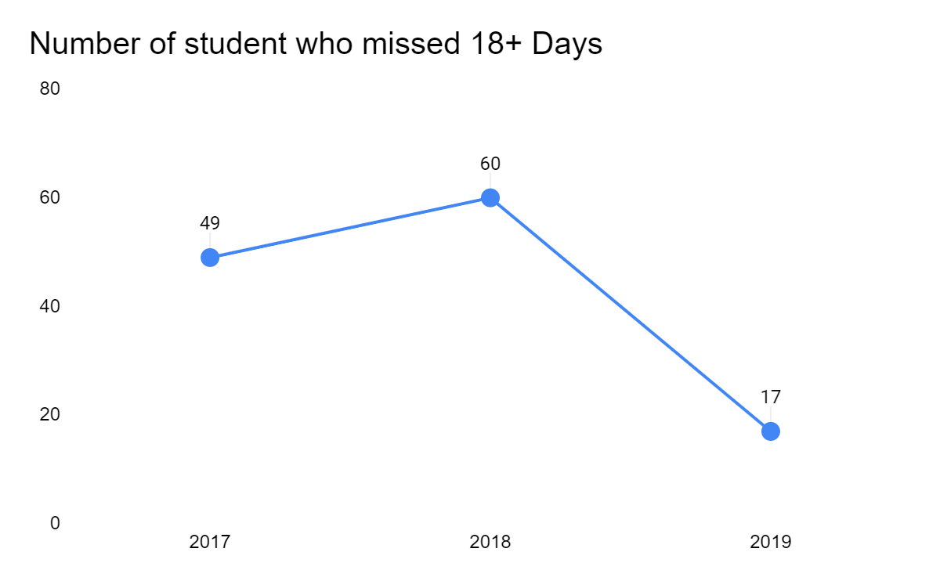
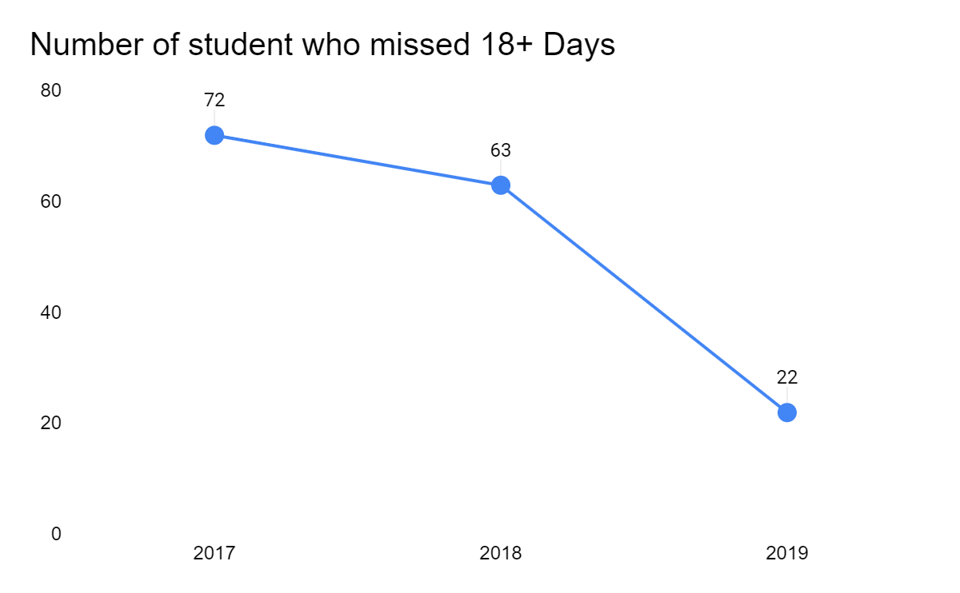
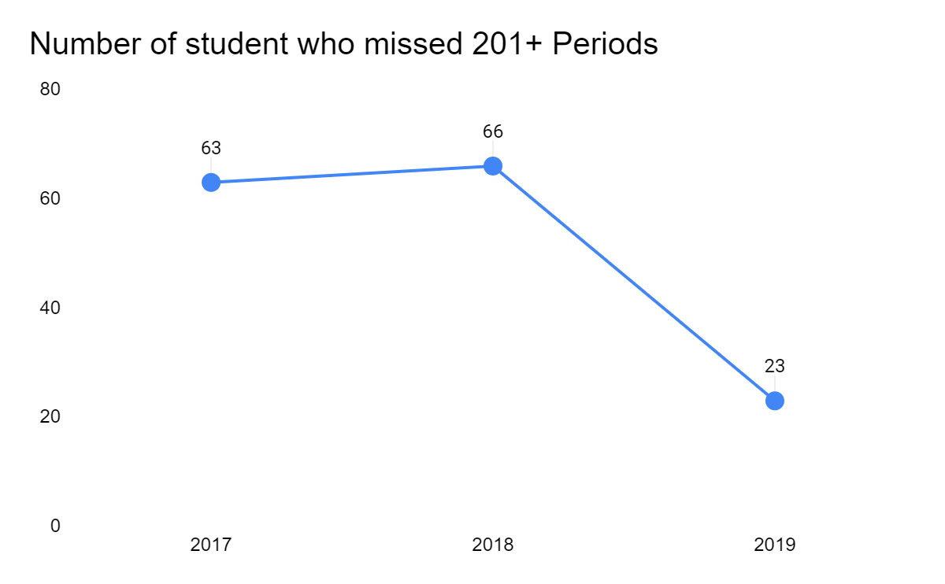
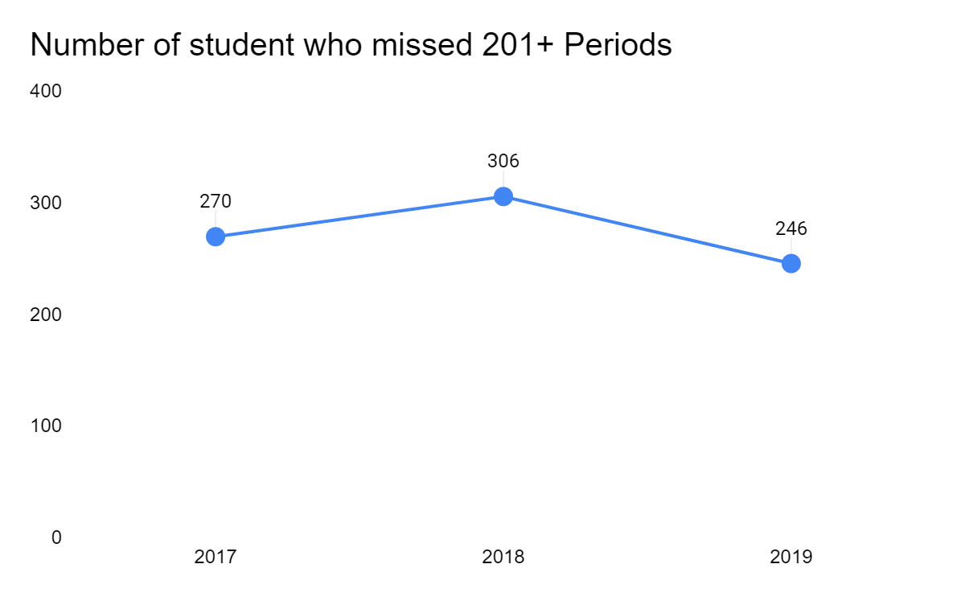
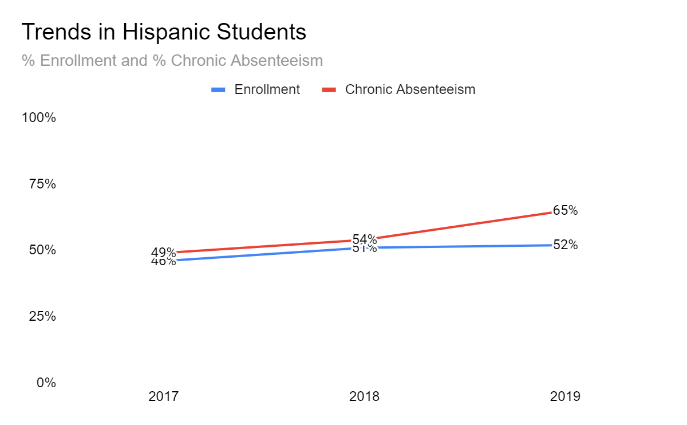
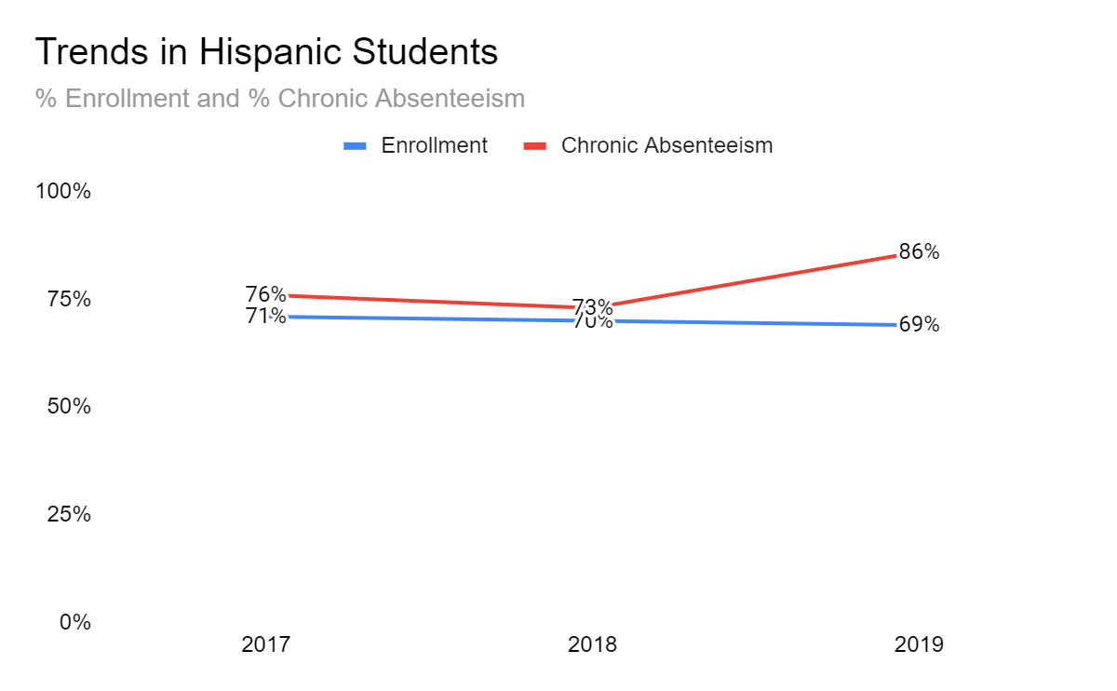
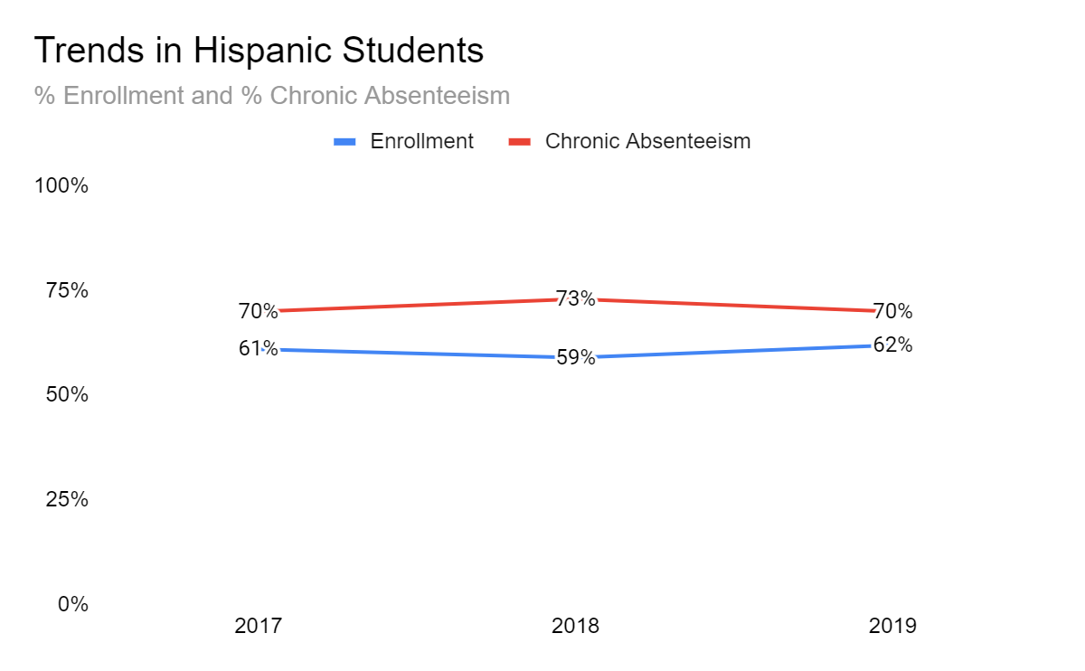
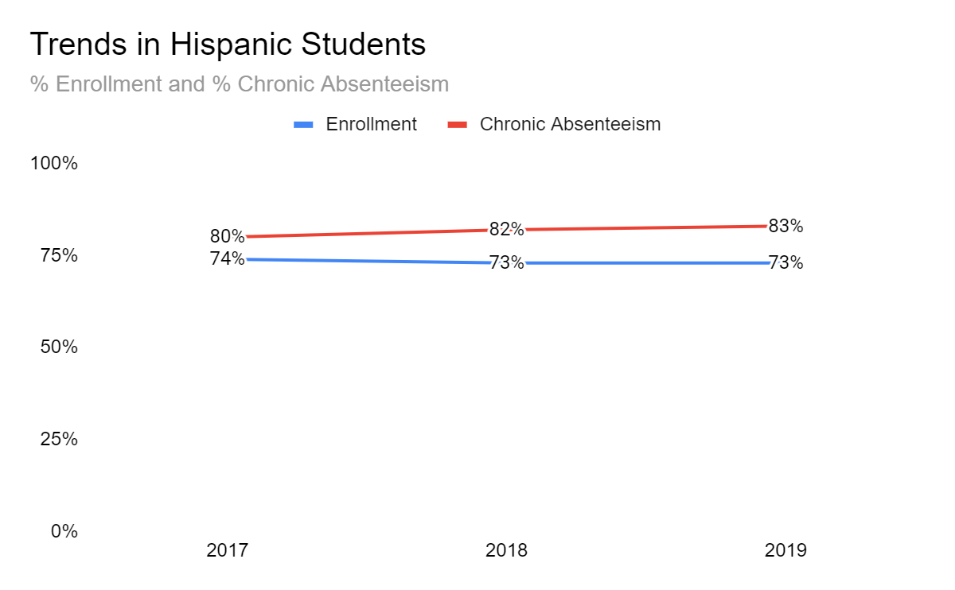
Attendance - Trends
Major Findings:
Chronic Absenteeism has been dropping over the last year years.
Hispanic students make up the largest percentage of Enrollment and Chronic Absenteeism
Hispanic students do not benefits as much as other groups as their proportion of Chronically Absent students is increasing at most schools.
Crockett Elementary
Hernandez Elementary
Miller Middle School
San Marcos HS

Slide 7
Discipline - Overview
Overview:
Our study focused only on incidents with removals (ISS, OSS, DAEP) over a 3-year period. Discipline rates were analyzed by race, gender, grade level and discipline description (Type of incident).
Sample:
Years Included: 2017-2018, 2018-2019, 2019-2020
Schools Included:
Crockett Elementary, Hernandez Elementary, Mendez Elementary, Miller Middle School, and San Marcos High School
Data for Goodnight Middle School was included in discipline data. This was the only dataset provided that included this school.

Slide 8
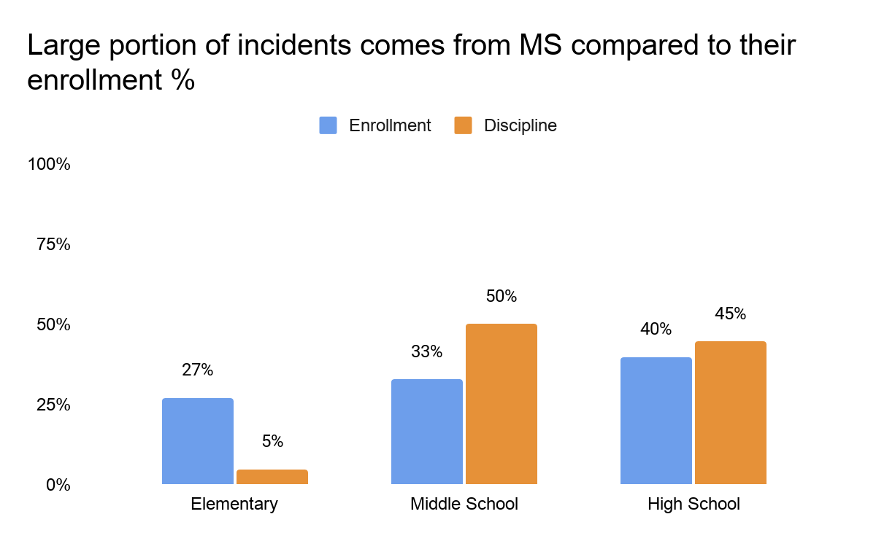
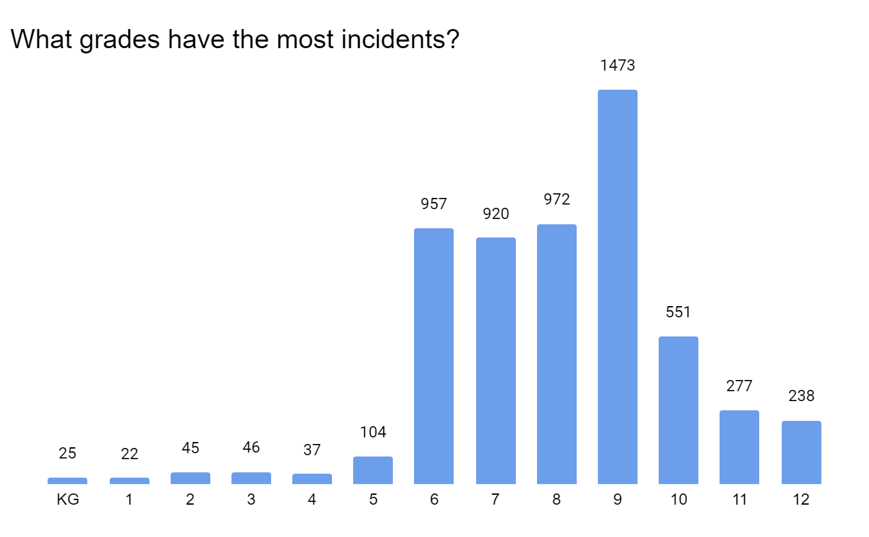
Discipline - School Type & Grade Level
Major Findings:
The middle school makes up a larger portion of incidents compared to their portion of the enrollment.
There are large jumps in the number of incidents from grades 5-6 and 8-9.
Our recommendation is focusing on the middle school grades for deeper analysis.

Slide 9
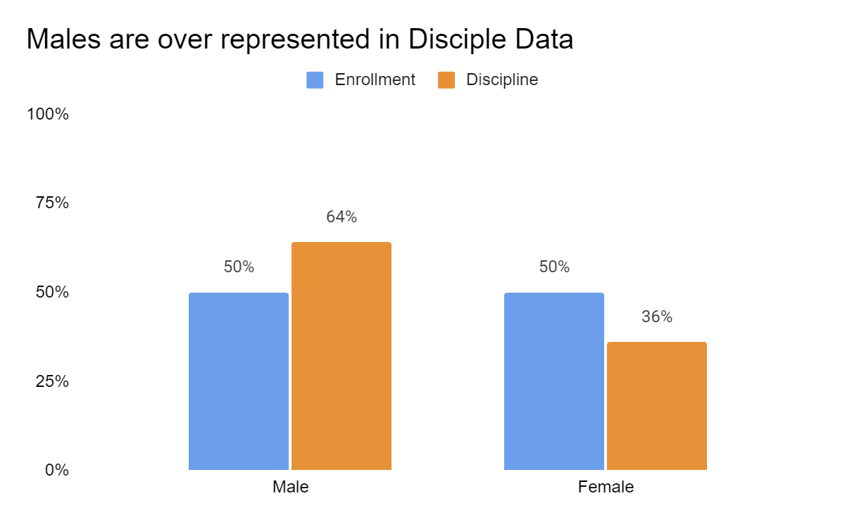
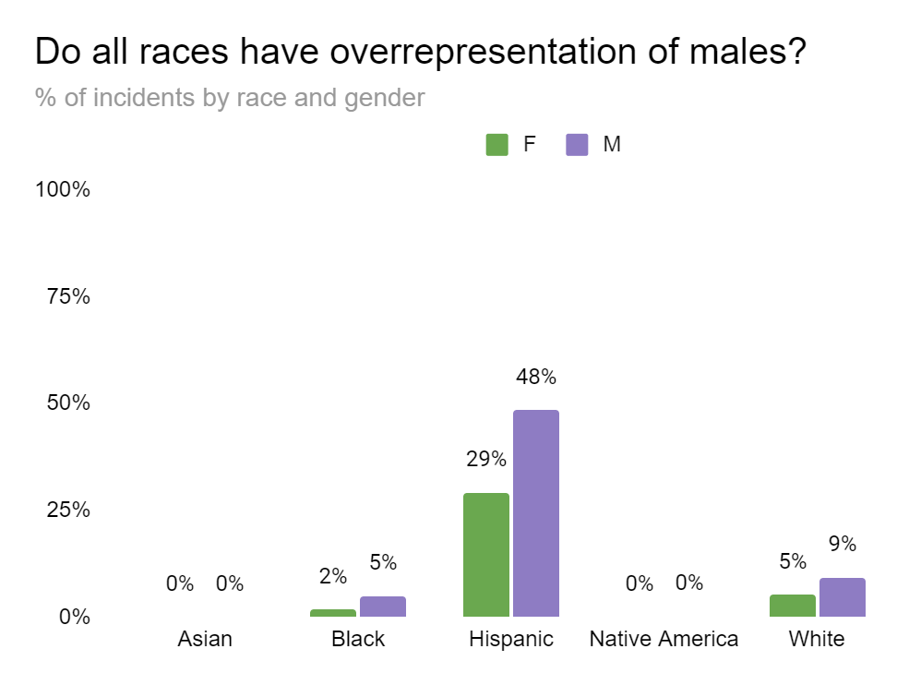
Discipline – Race and Gender
Major Findings:
There is a trend of males overrepresented compared to their proportion of enrollment. There is a 50-50 split between males and females in the populations. However, males make up 64% of incidents.
When looking at this data by races it continues to show all races have an overrepresentation of males with Hispanic males making up the largest percentage of incident data.
Males are over-represented in Discipline Data

Slide 10
Dropouts - Overview
Overview:
Our study focused on dropout data by race, gender, Economic Disadvantage designation, At-Risk designation, and Special Education designation, across three academic years.
Sample:
Years Included: 2017-2018, 2018-2019, 2019-2020
Schools Included:
San Marcos High School

Slide 11
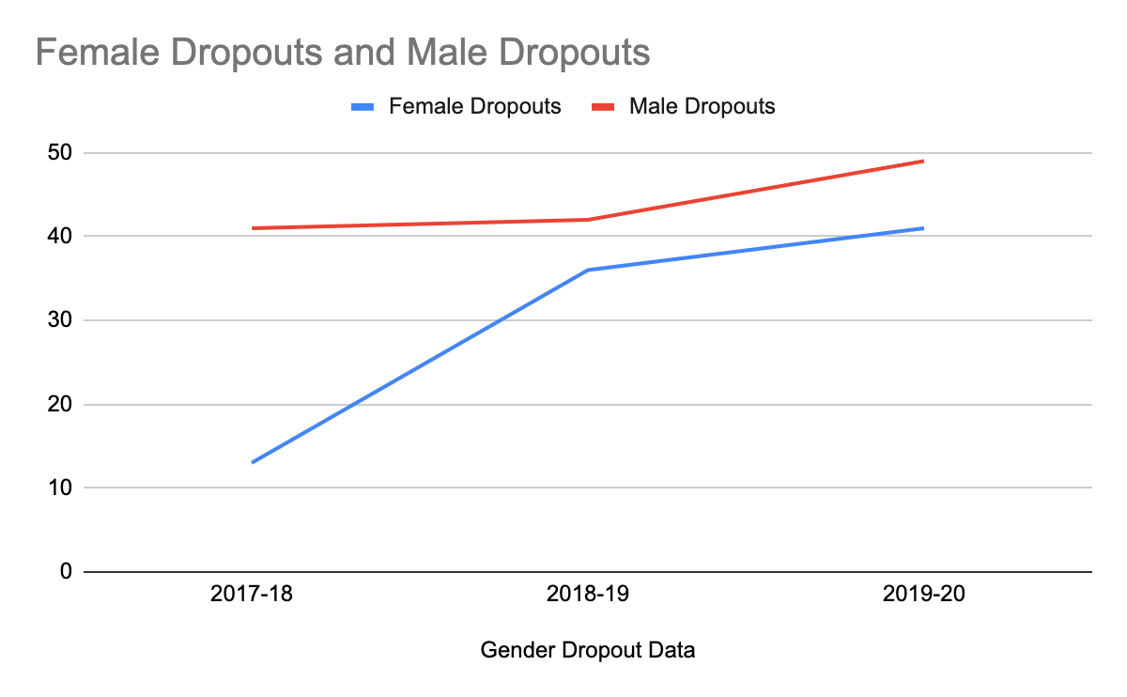
Dropouts - Gender
Major Findings:
San Marcos HS saw an increase in female student dropouts across three years.
The number of female dropouts spiked in 2018-19, with 36 female dropouts compared to 13 female dropouts in the year 2017-18.
There was a 3-year increase in male dropouts

Slide 12
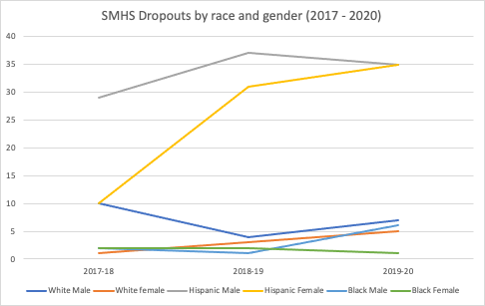
Dropouts – Race & Gender
Major Findings:
Most races saw an increasing trend in drop out rates
White males and Black females show a slight downward trend
Over three years we found:
A 3-year increase in Hispanic female dropouts
A consistent increase in White female dropouts.

Slide 13
Racial Climate Survey - Overview
Sample:
1181 students responded to the survey
82 staff members responded to the survey
Miller Middle School had the highest participation rate of 57% of the student population responding

Slide 14
Racial Climate Survey - Reporting Incidents
Major Findings:
Of the respondents who indicated they witnessed racism at their school only 24% (62) indicated they have reported acts of racism at their school.
262 students respondents indicated they have witnessed racism.
58 student respondents indicated were targets of racism.
Factors such as having a trusted adult, knowing how to report issues, and comfort level with reporting issues had some impact on reporting rates. However, the majority still indicated “No” for reporting issues.
This indicates there is still a major piece missing from San Marco CISD’s reporting process.
Students who indicated they witnessed racism
Comfortable Reporting Issues | Trusted Adult | Know how to report | Indicated "Yes" Reported Issues | Indicated "No" to reporting issues | Total # (N=)
Yes | Yes | Yes | 31% (27) | 59% (50) | 86
No | No | No | 20%(2) | 80% (8) | 10

Slide 15
Racial Climate Survey - Racial Putdowns
Major Findings:
The survey questions reflect direct examples of racism (put-downs and names) there are other forms of racism that are less direct and wouldn’t be reflected in these survey questions.
As we saw in incident reporting we suspect these to be under reported.
12% (31) of respondents who witnessed racism answered “No” or “I don’t know” for both students and adults.
Of the students who indicated witnessing racism only 10% reported “No” to hearing a student use a racial putdowns or name, only 55% reported “No” to hearing a student use a racial putdowns or name. While more reported hearing a racial putdowns from another student a large portion did report hearing racial putdowns from an adult.
Students who witnessed racism
 | I don't know | No | Yes
I have heard a student use a racial put-downs or name (N= 262) | 5% (14) | 10% (26) | 84% (220)
I have heard an adult use a racial put-downs or name (N= 262) | 17% (45) | 55% (145) | 27% (71)

Slide 16
Top Recommendations
Attendance
Investigate the intersection between suspension and chronic absenteeism, especially at Miller Middle School and San Marcos High School.
Discipline
Condense, streamline, and standardize discipline categories and consequences in order to reduce student suspensions.
Dropouts
Develop more intensive middle school strategies as well as 9th grade safeguards to reduce the number of 9th grade dropouts
Racial Climate
Enroll every school leader as well as designated district leaders in the Anti-Racist Leadership Institute™ to increase their racial literacy, confidence, and ability to successfully navigate and combat racism in San Marcos CISD
Anecdotal (Interviews with School Leaders)
Reduce supplemental supports and refocus on core instruction, classroom management, and student attendance

Slide 17
Questions?

Slide 18
San Marcos CISD
Curriculum & Instruction Audit

Slide 19
Curriculum & Instruction Audit
Project Overview
Big Rocks
Teacher Self Efficacy Findings
Culturally Responsive Teaching
Approach to Academics and Instruction
Q&A

Slide 20
Project Scope & Overview
Teacher Self-Efficacy Survey
Culturally Responsive Teaching Survey
Approach to Academic and Instructional Success Survey
Historical Academic Performance Data
Principal Focus Group
District Staff Interviews
Observations (n=15)

Slide 21
Big Rocks

Slide 22
Big Rocks- Relational Trust
Establish Trust
District
Administrators
Teachers

Slide 23
Big Rocks- Data Literacy
Acquisition
Management
Informed Instruction
Data Day

Slide 24
Big Rocks- Culture of Development
Reimagine Observation and Feedback
Professional Learning Communities
District-Wide Unit Planning Days
Lesson Study
Peer Observation
Continuity of Learning
Horizontal and Vertical
Cross-cutting Concepts
Differentiation

Slide 25
Big Rocks- High Academic Expectations
Higher Order Thinking Questions
Ratio- Teacher Talk to Student Talk
Increase student discourse
Cognitive Lift - Gradual Release
Shift the heavy lifting onto the students

Slide 26
Teacher Self Efficacy
Strengths
Classroom Management Systems
Alternative Explanations
Influencing and Reinforcing Classroom Rules
Opportunities
Family Engagement
Motivating Students
Managing Individual Student Behavior
Notes:
We didn’t see this translate in the suspension data…
Punitive and exclusionary practices.

Slide 27
Teacher Self-Efficacy - Recommendations
Provide district-wide recommendations for family engagement
Family Events (e.g. parent learning night)
Elevate Student Voice
Learning Partnerships (CRT)
Student Satisfaction Surveys
Provide resources for teachers to motivate students

Slide 28
Culturally Responsive Teaching
Strengths
Relationship Building
Establishing Trust
Build on Prior Knowledge
Opportunities
Greet English Learners in Native Language
Praise English Learning in Native Language
Parent Communication
Notes:
Opportunities help build a bridge between home and school. We have to talk about motivation. There’s a connection between teacher self-efficacy and their ability to be culturally responsive practitioners.

Slide 29
Culturally Responsive Teaching- Recommendations
Community Asset Mapping
District-wide PD on CRT
Zaretta Hammond- “CRT and the Brain”
Ready for Rigor Framework
Dr. Geneva Gay Dimensions of CRT

Slide 30
Academic and Instructional Approach
Strengths
Teach students about their cultural contributions to society
Opportunities
Collaborate with Teachers (other schools)
Collaborate with Curriculum Specialist (district)
Continuity of Learning
Understanding School and District Goals

Slide 31
Questions?

Slide 32
Appendices

Slide 33
Discipline - Incident Descriptions
Major Findings:
Code of Conduct violations make up the largest incident type.
There are over 100 different categories that are used.
Code of Conduct Violation is a broad description so looking at individual categories can give a better understanding of what incident types are related to removals.
Top 10 Category Student Code of Conduct Violation
Category | 2018 N= 1878 | 2019 N= 1690 | 2020 N= 1427
Skipping Class | 13% (237) | 11% (186) | 19% (274)
Tardy | 5% (98) | 3% (48) | 9% (135)
Disruption: Class | 5% (94) | 8% (139) | 9% (128)
No Category Listed | 4% (70) | 1% (22) | 5% (66)
Insubordination | 6% (112) | 7% (120) | 4% (51)
Class Misconduct | 14% (254) | 4% (63) | 4% (51)
Disruption: School | 2% (36) | 2% (39) | 4% (50)
Profanity toward Employee | 5% (87) | 3% (54) | 3% (46)
Slap/Hit | 2% (44) | 4% (60) | 3% (38)
Profanity | 5% (87) | 4% (67) | 2% (33)
Incident Descriptions by Year
Description | 2018 N= 2139 | 2019 N= 1926 | 2020 N= 1598
Student Code Conduct violation | 88% (1878) | 88% (1690) | 89% (1427)
Fighting | 5% (105) | 4% (75) | 3% (51)
Marijuana Or Other Controlled substance | 5% (98) | 4% (84) | 3% (46)
Assault-Other - Penal code 22.01(a)(1) | 1% (30) | 1% (25) | 2% (28)
All other Description Types | < 1% | < 2% | < 3%

Slide 34
Discipline - Length of Removal
Major Findings:
Below are a few examples of differences in the average duration of removal of Code of Conduct Violations by category.
Black and Hispanic students have a higher average removal time than other groups for most of the categories below..
Average Duration of Removal (=N Size)
Category | Asian | Black | Hispanic | Native American | White | No Data
Threats against students/staff or school property |  | 8.50 (4) | 6.30 (23) |  | 6.56 (7)
Threats/Intimidation |  | 4.33 (11) | 4.49 (36) |  | 2.38 (7) | 3.00 (2)
Confrontation: physical |  | 7.50 (6) | 5.83 (19) |  | 5.62 (9) | 1.00 (1)
Punching |  | 7.25 (2) | 3.11 (65) |  | 2.58 (19) | 2.00 (1)
Pushing/Shoving |  | 1.29 (6) | 2.53 (82) | 1.33 (3) | 1.50 (18) | 3.00 (2)
Prohibited Item (clarify in notes) | 1.00 (1) | 2.00 (2) | 4.09 (52) |  | 5.93 (12) | 3.00 (1)
Tobacco/Tobacco Products & Paraphernalia |  | 2.17 (5) | 1.98 (40) |  | 1.69 (9) | 2.00 (1)

Slide 35
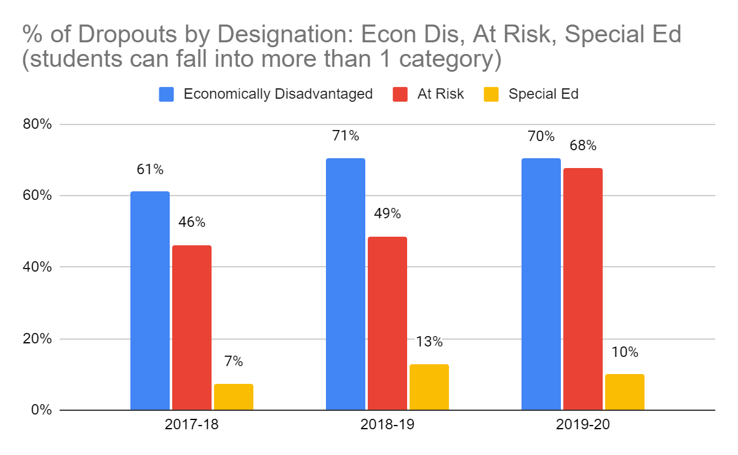
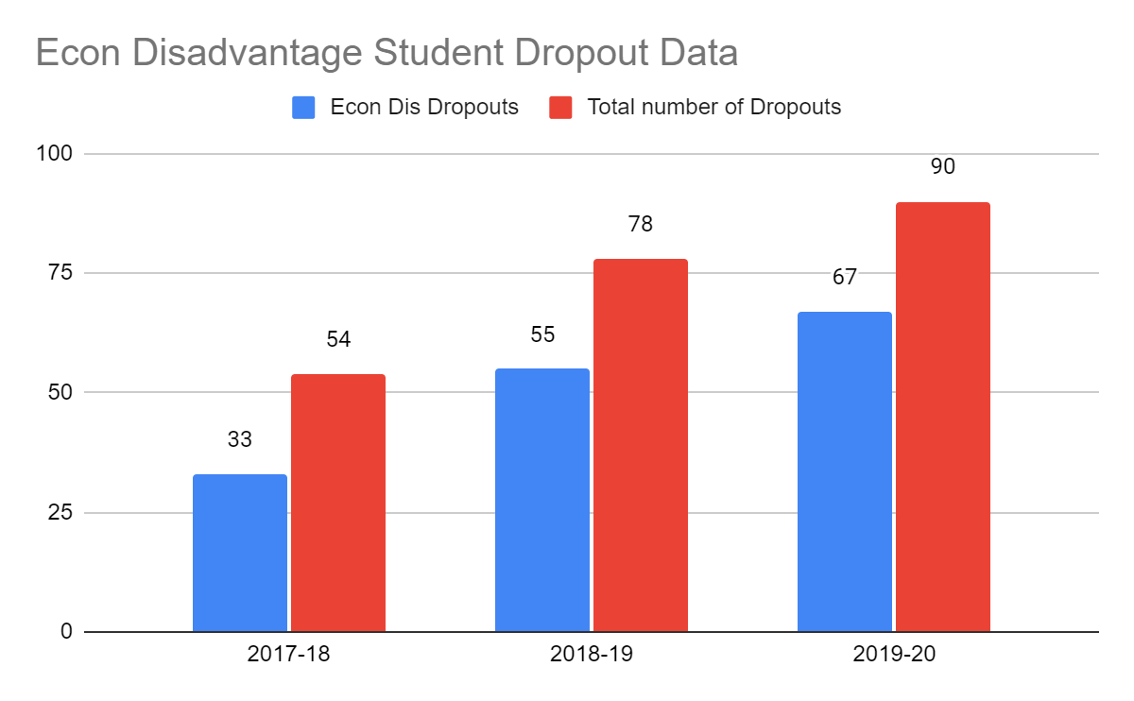
Drop Outs - Designation (Economic Disadvantage, At-Risk, or Special Education)
Major Findings:
Students who are categorized as economically disadvantaged make up a majority of overall dropouts for all three years.
There is a consistent overlap in students who are designated Economically Disadvantaged and also designated “At Risk”.
San Marcos HS saw an increase in at-risk students dropping out over the course of 3 years
The numbers were too low to determine a trend in student dropouts with a Special Ed designation.

